Slide 1

REAL TIME ELECTRICITY MARKET AND GREEN ENERGY TRADING IN INDIA And FURTHER..
Presented By:
Annu Mary Zacharias ,MIET

Slide 2

Introduction
India started its exchange-based electricity market in 2008 on Term ahead basis
Increased integration of Renewable Energy and distributed generation as part of Net zero targets all over the world and in India .
Resultant increase in fluctuation of generation and Demand .Need of real-time balancing of Power system.
Need of flexibility services

Slide 3
Lets Know ,Organizational Structure of Indian Grid and Regulatory Bodies
DISPATCH CENTRES:
POWER GRID Corporation Lmtd (POSOCO)
NLDC- National Load Dispatch Centre
RLDC- Regional Load Dispatch Centre
SLDC- State Load Dispatch Centre
REGULATORY BODIES:
Ministry of Power
Ministry of New and Renewable Energy
CEA-Central Electricity Authority
CERC- Central Electricity Regulatory commission
SERC- State Electricity regulatory commission

Slide 4
CENTRAL ELECTRICITY AUTHORITY- Formed under Electricity act 2003
Main function : advise the Central Government on the matters relating to the national electricity policy, formulate short-term and perspective plans for development of the electricity system and co-ordinate the activities of the planning agencies for the optimal utilization of resources to subserve the interests of the national economy and to provide reliable and affordable electricity for all consumers.
specify the technical standards for construction of electrical plants, electric lines and connectivity to the grid.
specify the safety requirements for construction, operation and maintenance of electrical plants and electric lines
specify the Grid Standards for operation and maintenance of transmission lines;
CERC
To regulate the tariff of generating companies owned or controlled by the Central Government
to regulate the tariff of generating companies other than those owned or controlled by the Central Government specified in clause (a), if such generating companies enter into or otherwise have a composite scheme for generation and sale of electricity in more than one State
To regulate the inter-State transmission of electricity
To determine tariff for inter-State transmission of electricity;
To issue licenses to persons to function as transmission licensee and electricity trader with respect to their inter-State operations;
to specify and enforce the standards with respect to quality, continuity and reliability of service by licensees;
SERC
The determination of electricity tariffs for generation, supply, transmission, and wheeling, whether for wholesale, bulk, or retail purposes within the State.
The regulation of the electricity purchase and procurement process of distribution licensees, including the pricing of electricity procurement from generating companies, licensees, or other sources for distribution and supply within the State.
The facilitation of intra-State transmission and wheeling of electricity.

Slide 5
Electricity Trading Markets levels in India
Term Ahead Market (TAM)
Day Ahead Market (DAM)
Real Time Market(RTM) –Started in 2020
Electricity Trading Markets Platforms in India
Indian Energy Exchange (IEX)- 2008
Power Exchange of India Limited (PXIL)- 2008
Hindustan Power Exchange Limited (HPX)- 2022

Slide 6
REAL TIME MARKET of ELECTRICITY
Basically, represents trading of the energy on the same day of Dispatching it
The closer the trading time to the dispatch time , customers can trade with more accuracy that means less unexpected fluctuations in grid .
In Indian Real Time Electricity Market, the Trading window for a slot of energy is 1 hr. 15 minutes prior to the corresponding dispatch time .
Electricity act 2003 and Electricity market regulations 2010 and their amendments are the main laws and regulation which controls Endian Electricity market .

Slide 7
Features of Indian RTM of Electricity
15-minute window for trading
Day is divided into 48 slots of 30 minutes each
Auction taking place in 3 platforms
Both Renewable and Non-renewable energy can be traded in the same window
Zone wise trading , total of 13 zones

Slide 8
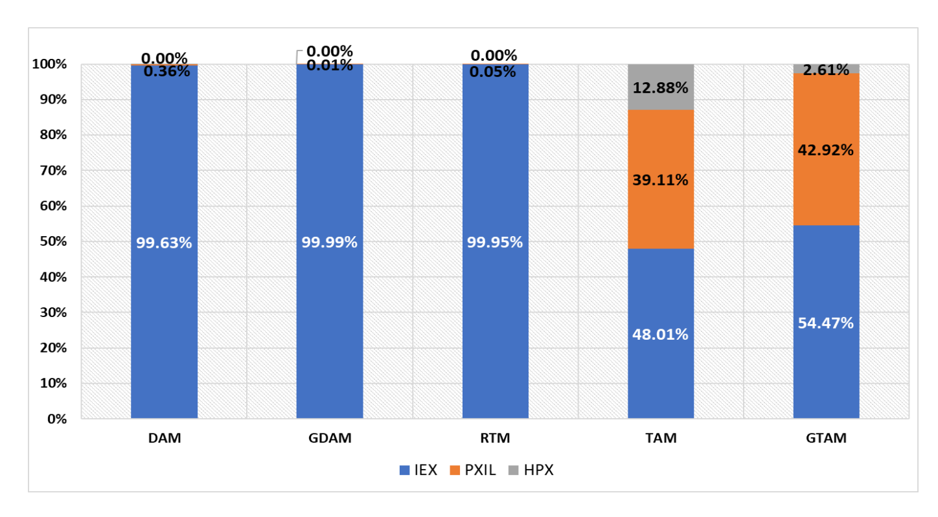
Share of Volumes cleared in different exchanges in 2022-2023

Slide 9
Who can Participate in RTM ?
The trading of electricity in India, you should have a license to do so issued by the electricity regulatory commission according to electricity act 2003.
But if the participant is a distribution licensee or transmission licensee , then they does not need separate trading license
According to the electricity act, the National, regional and state load dispatch centers are not permitted to trade in the market
Must be Participated in DAM

Slide 10
Timeline of RTM India

Slide 11
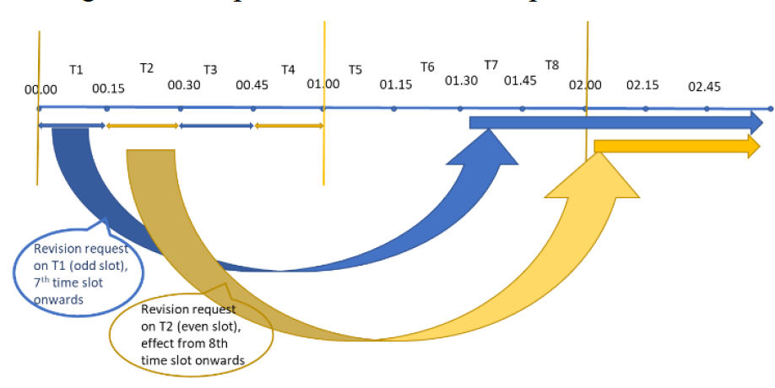
Right to revision implementation

Slide 12
Transmission corridor availability and allocation in RTM
Allocation of the transmission corridor availability between the PXs is based on their share in the cleared volumes in the DAM
The minimum allocation of corridor availability for the PX is set as 10%.
The PX should maintain the cleared volume in RTM is within the standing clearance submitted by the entities.
PXs shall club all Buyers and all Sellers State wise for Scheduling by RLDCs.
If the trade cleared by any PX is more than the allocated corridor availability, then NLDC will consider the trade done by that particular PX for the period as zero

Slide 13
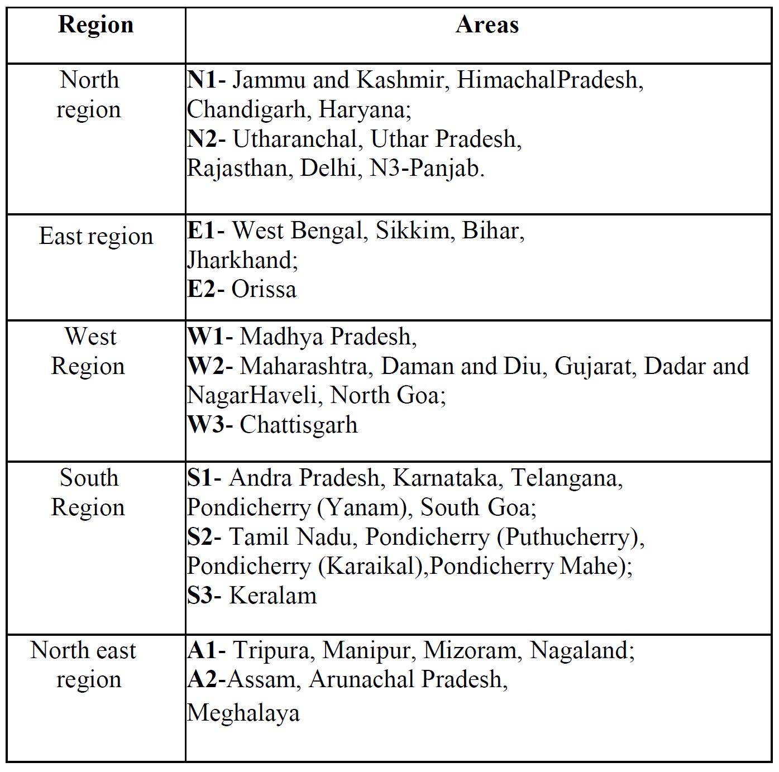

Slide 14
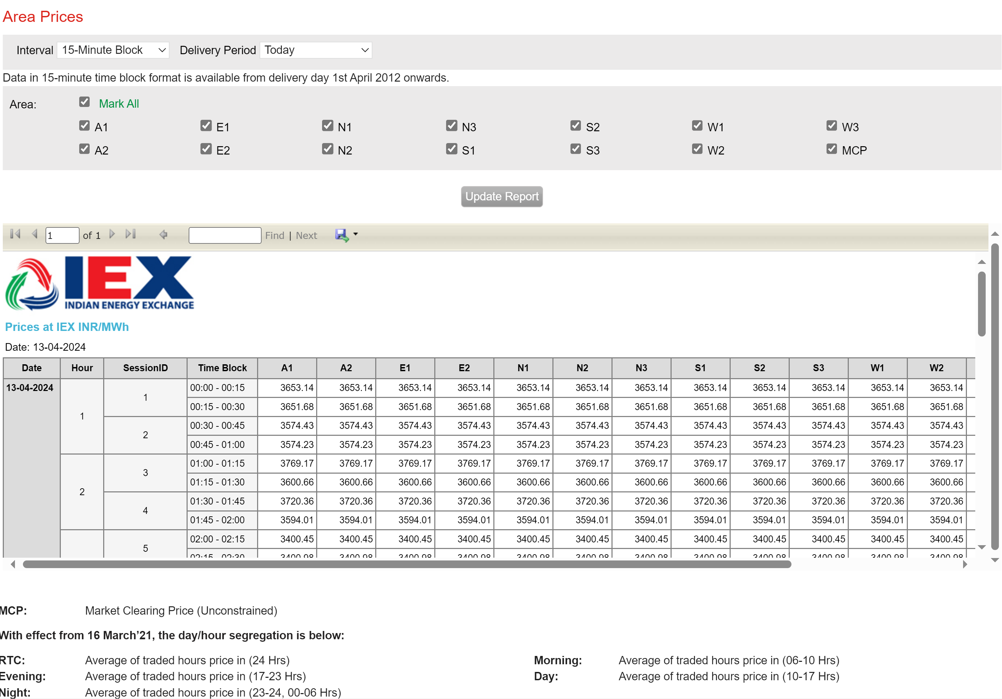
ZONE WISE BIDDING

Slide 15
Let’s have a look in IEX and PXIL IEX | Indian Energy Exchange Limited | IEX India PXIL Market | Power Exchange India Limited|Energy Exchange

Slide 16
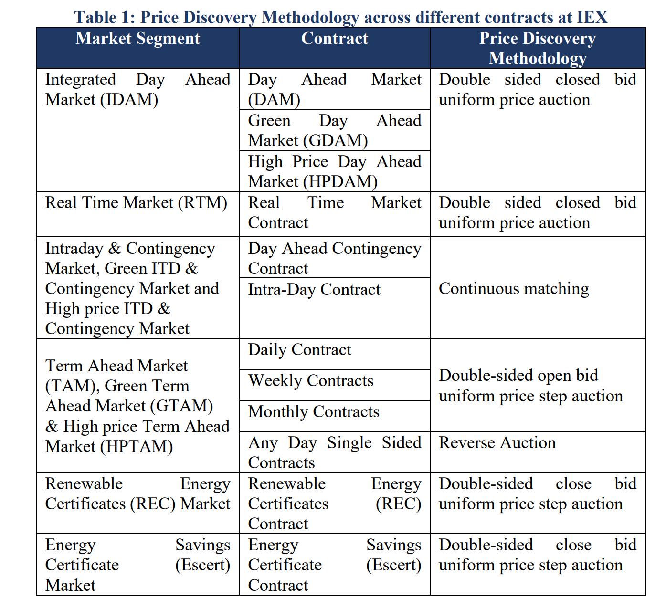

Slide 17
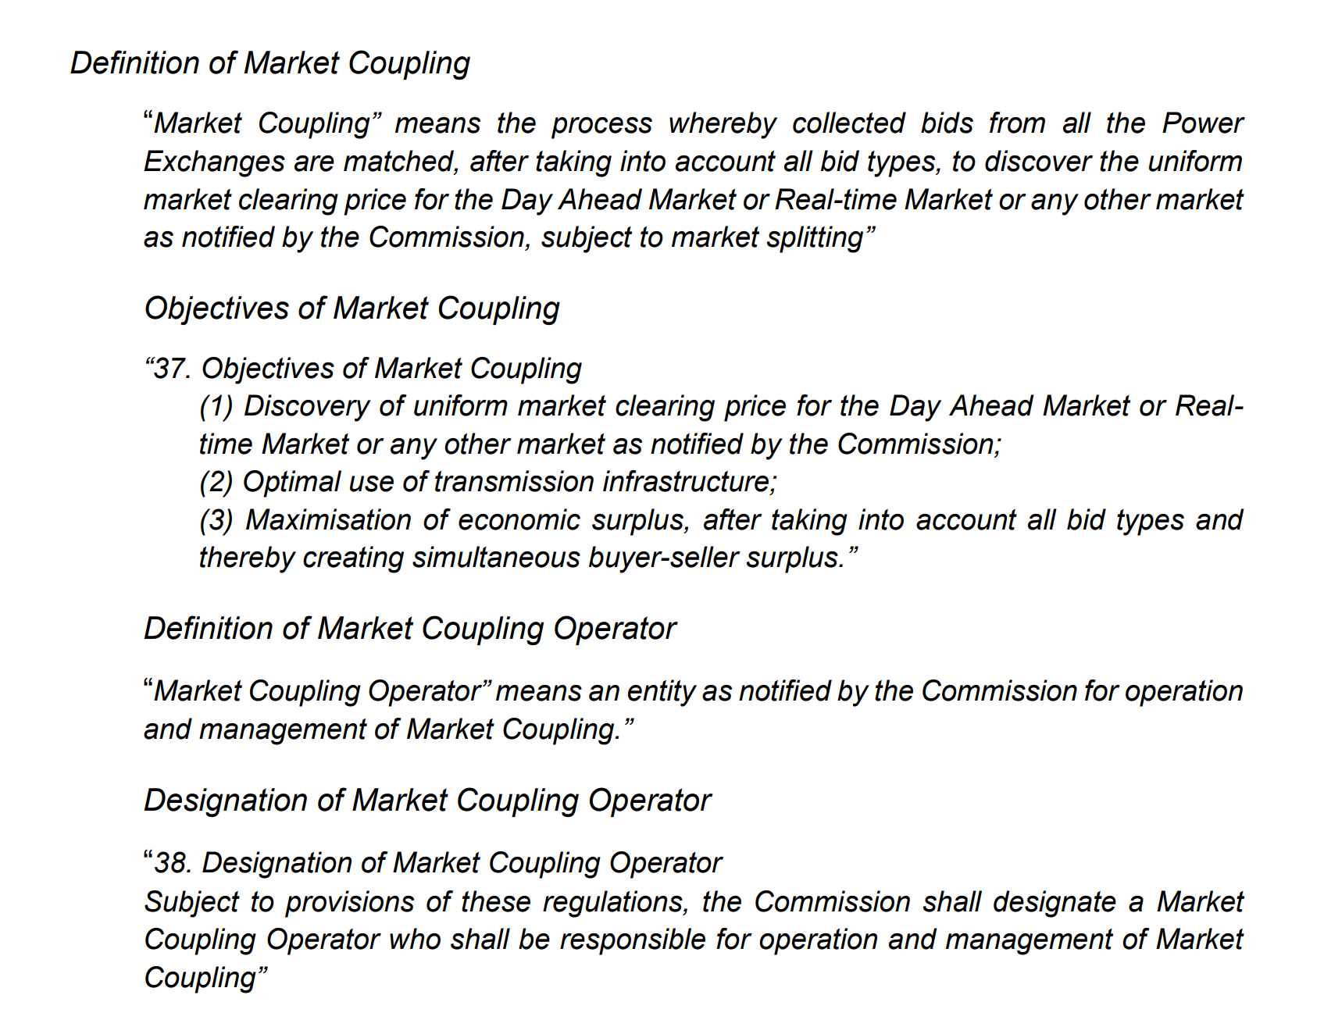

Slide 18
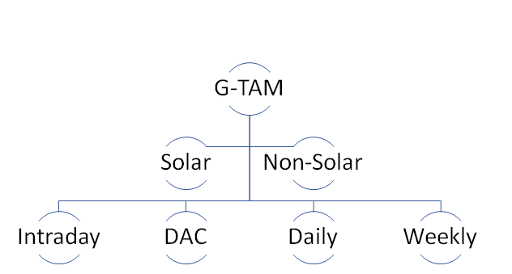
Green Energy Trading in India
They are traded nationwide not area wise
Intraday – allowed till 3.5 hours prior to delivery
DAC-The trading session is from 1500 to 2300 hrs. each day for the next day delivery
Available for trading on each trading day for delivery of electricity on T+2 (T = trading day) day onwards.
Available for trading on every Friday and Saturday for delivery of electricity in the upcoming week from Monday to Sunday
No interstate transmission charges of RE

Slide 19
How TSO/DSO mange the unexpected fluctuations happening after RTM clearing?
Flexibility services market- At the moment India don’t have a flexibility service market but utilizes Un-Requisitioned Surplus capacity after clearing the market
Ancillary services Market- TRAS traded in Day ahead basis and RTM basis in market Plat form from May 2023
SRAS and FRAS not traded on market

Slide 20
THANK YOU

